Slide 1
Node.js Workshop for backend
Session 0: Introduction

Slide 2
Workshop timeline
Session 0
Session 1
Session 2
Session 3
Introduction to JS
Introduction to node and module systems
REST APIs and HTTP protocol
Express.js – MVC - MongoDB
Session 4
Session 5
Session 6
Session 7
Web security and user authentication
Git and GitHub
-Testing
CI - Deployment [Render – AWS]
Final project

Slide 3
Table of contents
01
02
03
04
Introduction to JS
Basic syntax
What is JavaScript and why to learn it
Basic syntax of JavaScript
How JS works
Asynchronous syntax
The internals of JavaScript
Callbacks – Promises – Async Await

Slide 4

01
Introduction to JS
What is JavaScript and why to learn it

Slide 5

What is JS
JavaScript is one of the three core web technologies. HTML, CSS, and JavaScript
JavaScript is a high-level programming language used for creating dynamic and interactive web pages
It was created by Brendan Eich, a programmer working at Netscape in 1995. JavaScript was originally developed under the name "Mocha" and later renamed to "LiveScript" before settling on its current name.

Slide 6
What can we do using JS
Frontend development
React, Angular, Vue, Next, Nuxt, Svelte, Qwik, Remix, Solid, Backbone, jQuery, Ember, Preact, and more
Backend development
Node.js or Deno

Slide 7








What else we can do with JS
Mobile development
React Native, Ionic
Desktop development
Electron.js

Slide 8



What else we can do with JS
Machine learning
Tensorflow.js
Embedded systems and IOT
Johnny-Five, Cylon.js

Slide 9
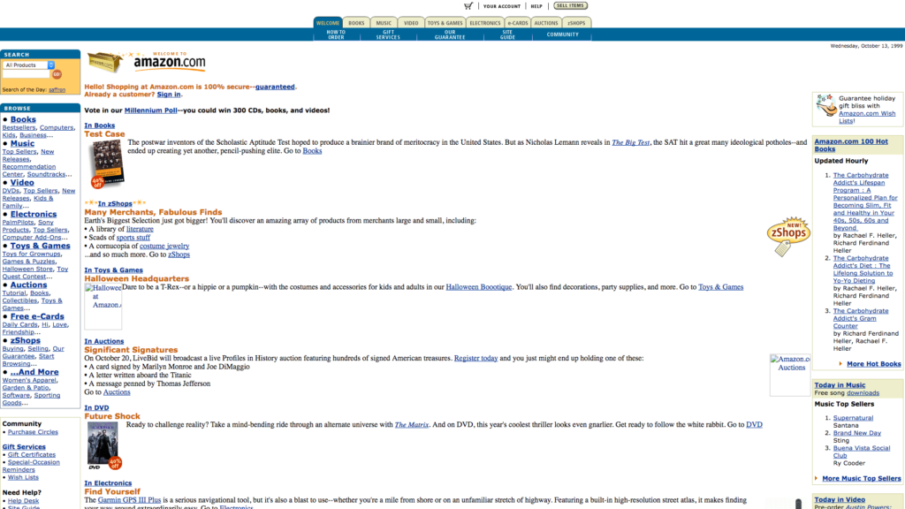
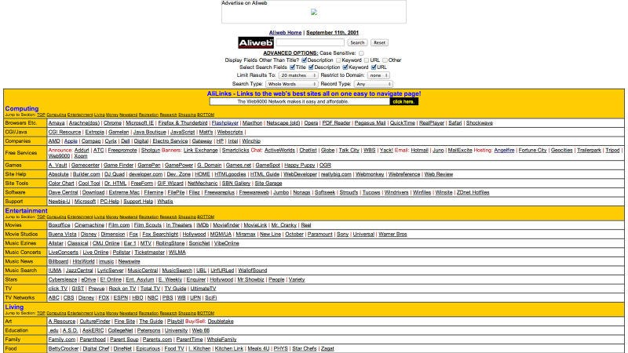
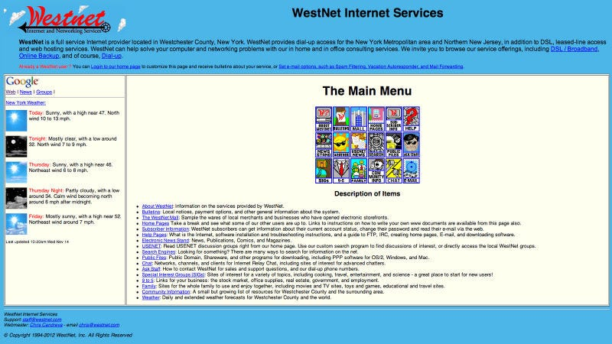
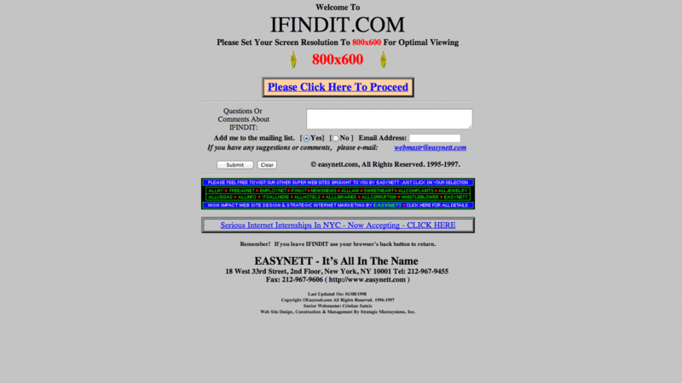
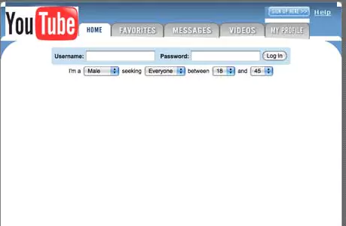
Web before JS

Slide 10

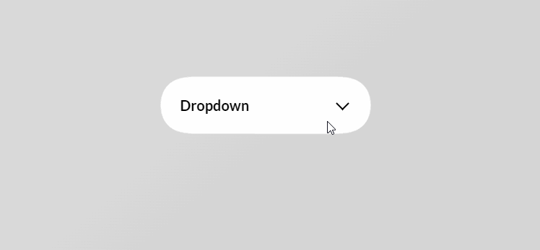
Web with JS

Slide 11
02
Basic syntax
The basic syntax for JavaScript

Slide 12
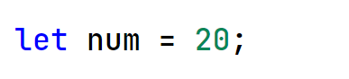
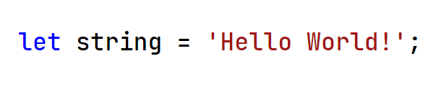
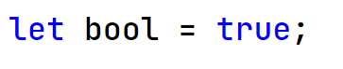
Data types
Number
numbers are stored as double-precision 64-bit binary format IEEE 754 values, like double in Java or C#
String
a sequence of characters
Boolean
True or False

Slide 13
Data types
BitInt
A BigInt is a primitive data type in JavaScript that represents numeric values which are too large to be represented by the Number primitive

Slide 14
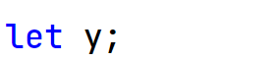
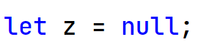
Data types
Undefined
A variable has been declared, but no value has been assigned to it yet. It is also the default value of function parameters if no value is passed in
Null
represent the intentional absence of any object value.

Slide 15
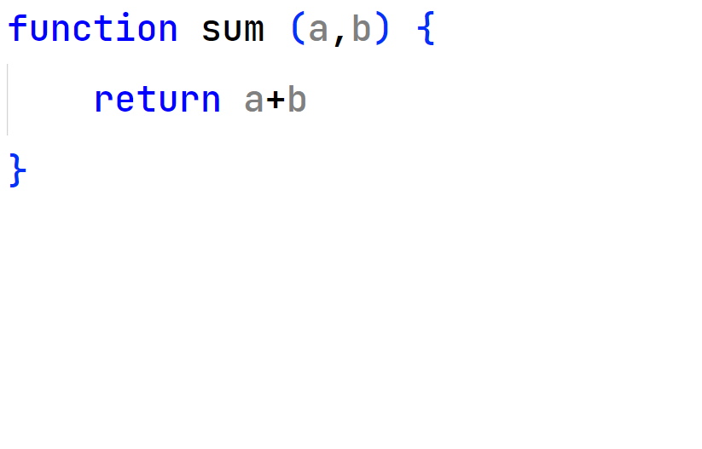
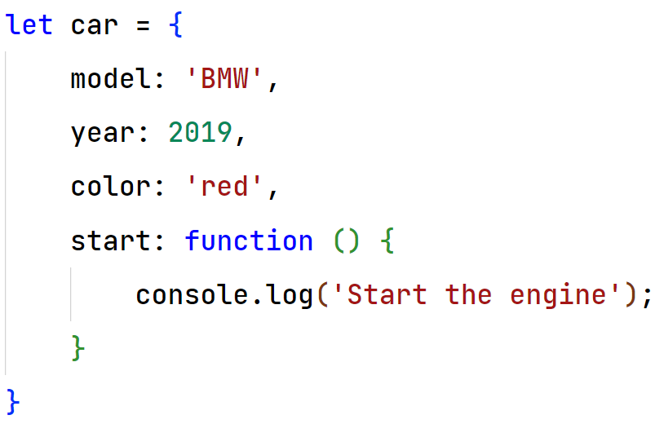
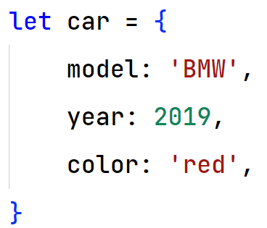
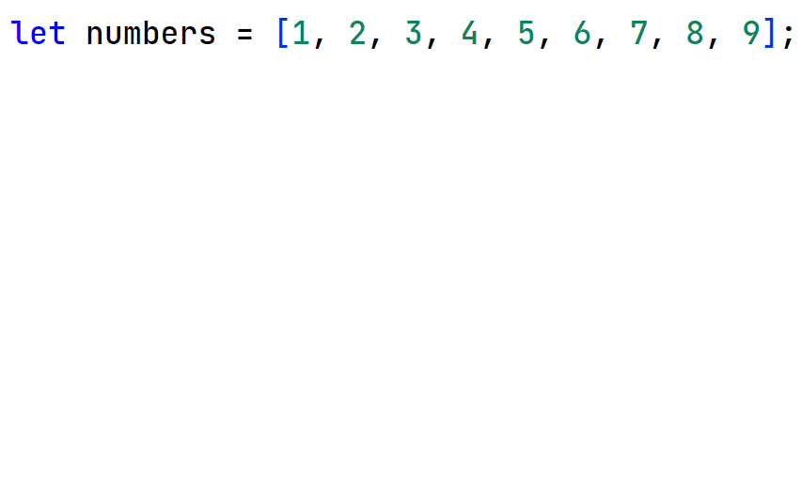
Data types
Object
Object in JavaScript is used to represent a collection of properties in the form of name and value pairs. It is the most important data types in JS.
All complex data types are Objects in JavaScript

Slide 16
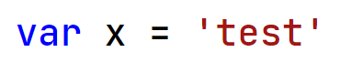
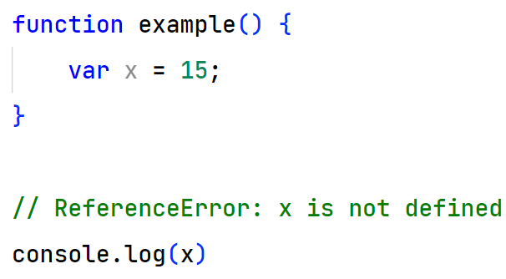
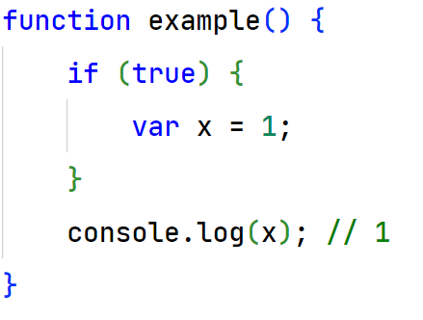
Declaring a variable
var
Function scope instead of block scope Variables defined with var are partially hoisted

Slide 17
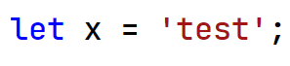
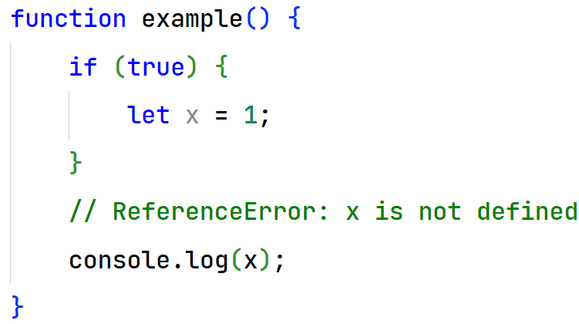
Declaring a variable
Let
Function scope and block scope

Slide 18
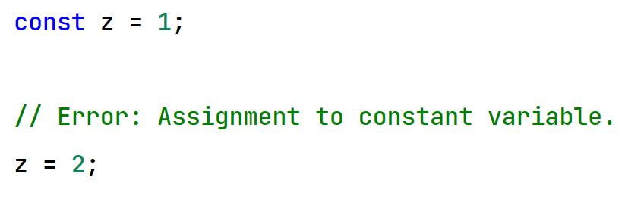
Declaring a variable
Const
Function scope and block scope

Slide 19
Arrays
Array
store multiple values in a single variable
Arrays have a “length” property that returns the number of elements in the array
Arrays can store elements of different data types in the same array

Slide 20
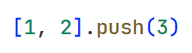
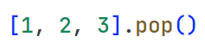
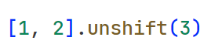
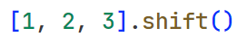
Arrays methods
push
Add element to [end] the array
pop
remove element from [end] the array
shift
remove element from [beginning] the array
unshift
Add element to [beginning] the array

Slide 21
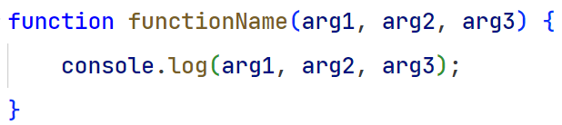
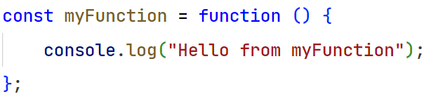
Functions
Function
Functions are reusable blocks of code
Functions in JS are objects

Slide 22
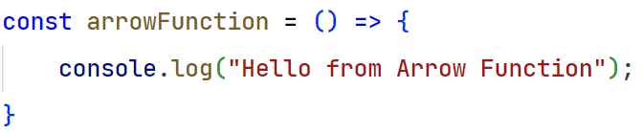
Function shapes
Normal function
Anonymous function
Arrow function

Slide 23
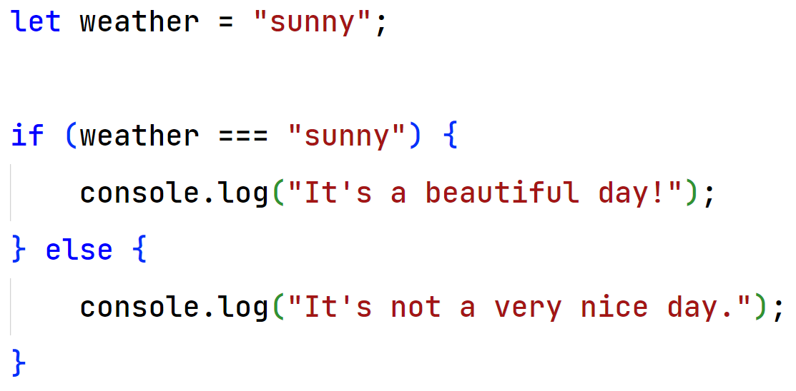
Conditions
If else

Slide 24
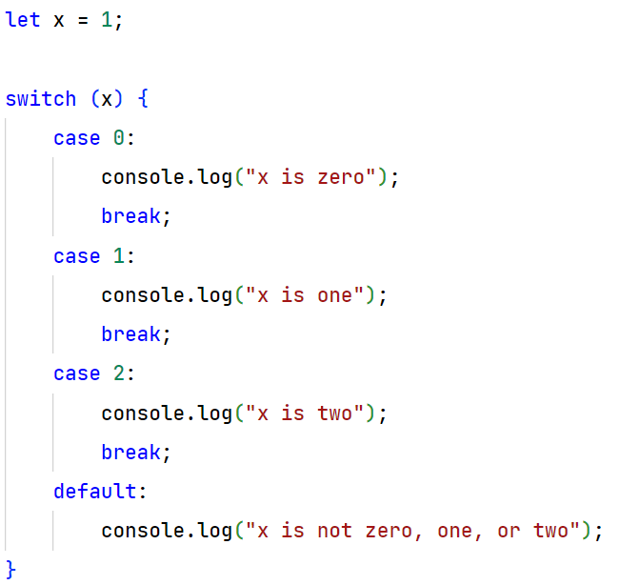
Conditions
Switch case

Slide 25
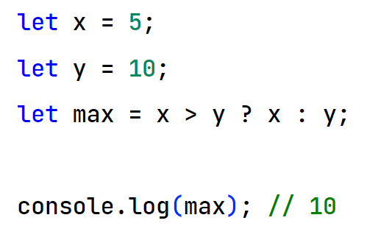
Conditions
Ternary operator
Condition ? valueIfTrue : valueIfFalse

Slide 26
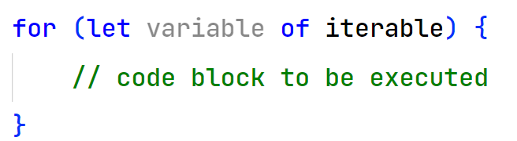
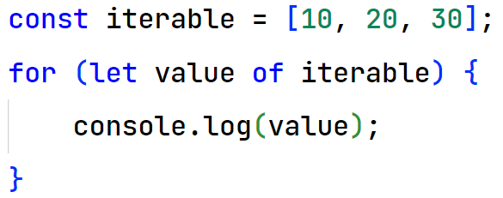
Loops
For of

Slide 27
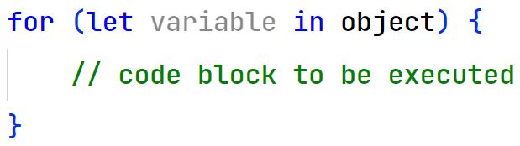
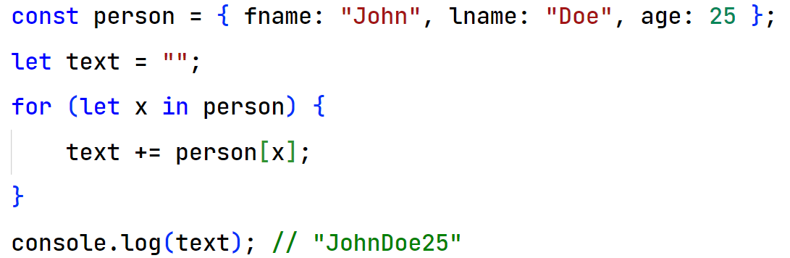
Loops
For in

Slide 28
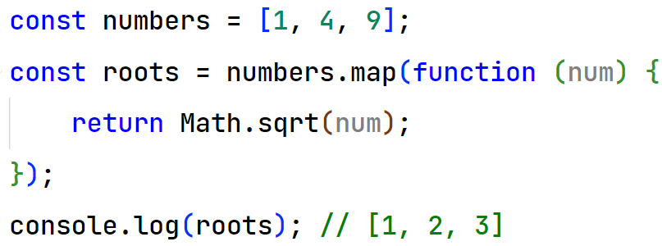
Loops
map
array.map(callbackFn)

Slide 29
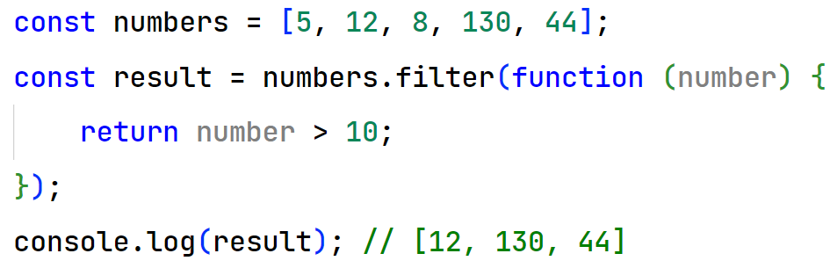
Loops
filter
array.filter(callbackFn)

Slide 30
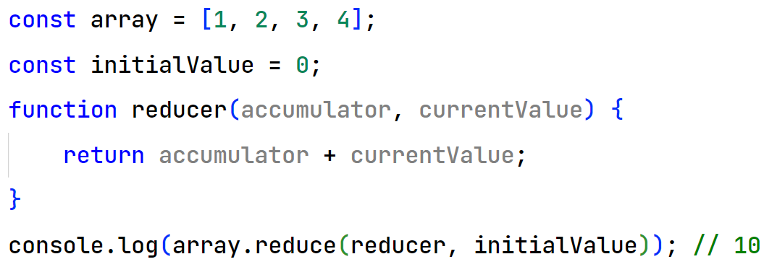
Loops
reduce
array.reduce(callbackFn)

